Slide 1
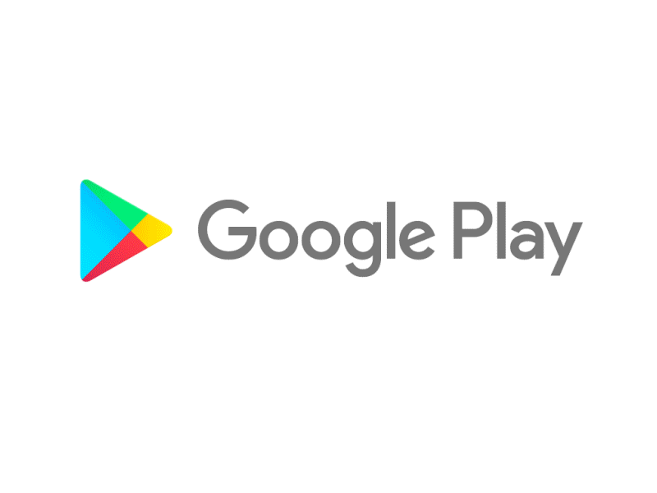

Capstone Project
Play Store App Review Analysis
By
ANIL YADAV
Data Science Trainee, AlmaBetter

Slide 2








WHY ANALYZE THE GOOGLE PLAY STORE?
Mobile App Market is set to grow 20% by 2023
Android Apps comprise 90% of the Mobile App Market
What are some interesting patterns in user behavior related to app usage & feedback
What makes an App popular? Can we predict how popular it’s going to be?
To Study the scam review that use by people
Why the Fake reviews Can we stop the stop this

Slide 3

Introduction
Android is the most popular operating system in the world, with over 2.5 billion active users spanning over 190 countries.
Google Play was launched on March 6, 2012, bringing together Android Market marking a shift in Google's digital distribution strategy .
Android is the dominant mobile operating system today more than 85% of all mobile devices running Google’s OS. The Google Play Store is the largest and most popular Android app store.
There are more than 3.04 million apps found on Google Play Store.
The Play Store apps data has enormous potential to drive app-making businesses to success.
Actionable insights can be drawn for developers to work on and capture the Android market. The main goal of our project is-
The purpose of our project is to gather and analyze detailed information on apps in the Google Play Store in order to provide insights on app features and the current state of the Android app market.
The Objective of the project to Explore and analyze the data to discover key factors responsible for app engagement and success.
The paly store apps data has emormnous potential to drive app –making businesses to success.Actionable insights can be drawn for developers to work on and capture the Android market .Each app has value for category ,rating ,size ,and more .Another data set contains customers reviews of the android apps .Explore and analyse the data to discover key factors responsible for app

Slide 4


Problem statements:
Two datasets are provided, one with basic information and the other with user reviews for the respective app.
We must examine and evaluate the data in both datasets in order to identify the important characteristics that inﬂuence app engagement and success.
So, what factors inﬂuence an app's success?
An app is said to be successful if it has:
A high average user rating
A good number of positive reviews
A good number of monthly average users
High revenue per customer and so on.

Slide 5
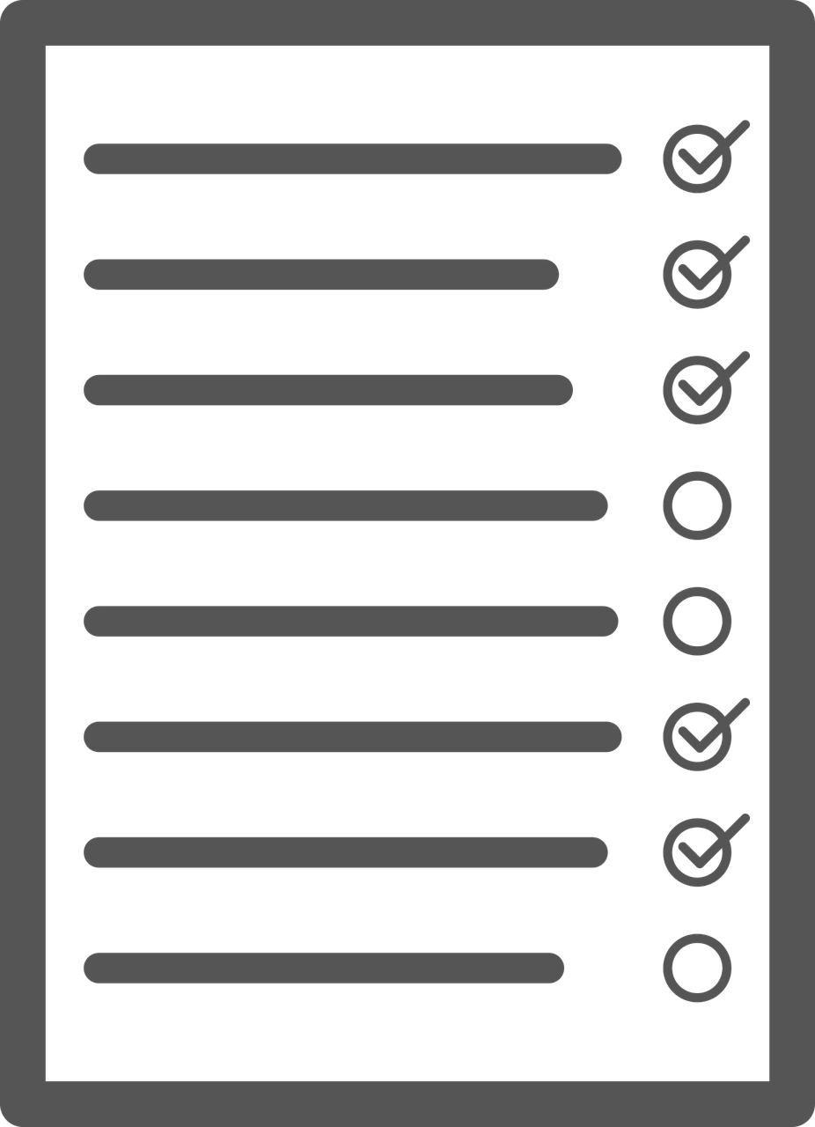
Agenda
Introduction
Category wise play store apps installs
Category wise most popular apps
Top 10 apps in play store considering all the parameters
Average installs, category wise
Most installed apps in communication category
Average sizes of apps in each category
Category wise percentage of paid apps
Category wise top installed paid apps
Average rating rating of paid apps
Correlation between Rating ,Installs and Price
Category wise installed apps with content rating
Percentage reviews sentiment distribution

Slide 6


Dataset Preparation
Loading the data sets: Two datasets, First Play store app dataset and User Reviews dataset.
Import Libraries: NumPy, Pandas, Seaborn and Matplotlib
Data cleaning: Null values, Finding and removing Outliers, Removing duplicate data.
Data Imputation: Filling the missing categorical values with mode and numerical values with median. Conversion of price, installs, reviews into numerical values.
Exploratory Data Analysis: Analyzing the data sets to summarize their main characteristics using statistical graphics and data visualizations method.

Slide 7

Attributes in User reviews
App- Application name
Translated Review- User review
Sentiment- Positive/Negative/Neutral
Sentiment Polarity- Sentiment polarity score
Sentiment Subjectivity- Sentiment subjectivity score
EDA-Exploratory Data Analysis

Slide 8




OVERVIEW OF ANALYSIS
Data Cleaning
Data Exploration
Predictive Modeling
Review analysis
Understand the structure of the dataset and clean data before analysis
Uncover initial patterns, characteristics, and points of interest using visual exploration
Formulate a statistical model to forecast an outcome using relevant predictors
To analysis the what type off Review’s are given

Slide 9
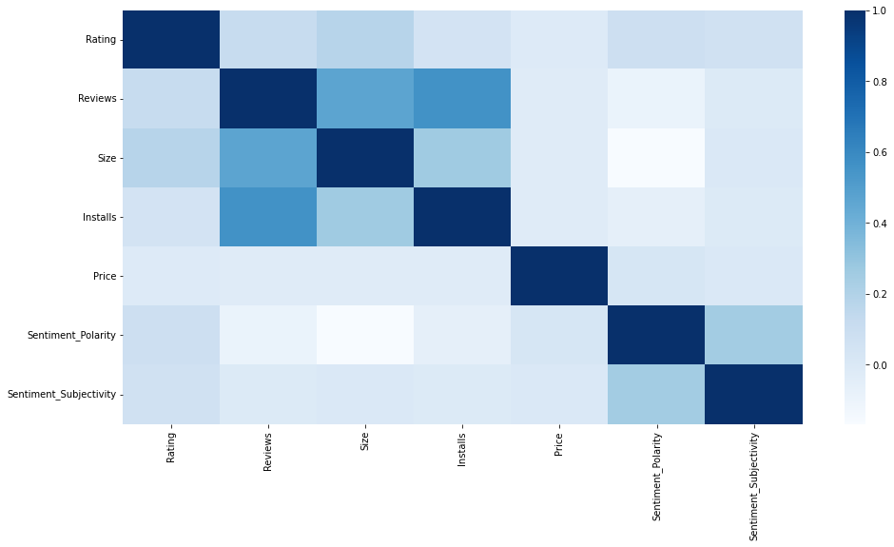
Correlation Heatmap
❏ The Rating is slightly positively correlated with the Installs and Reviews.
❏ The Price is slightly
negatively correlated with
and
the Rating, Reviews, Installs.
❏ There is a strong positive correlation between the Reviews and Installs.

Slide 10
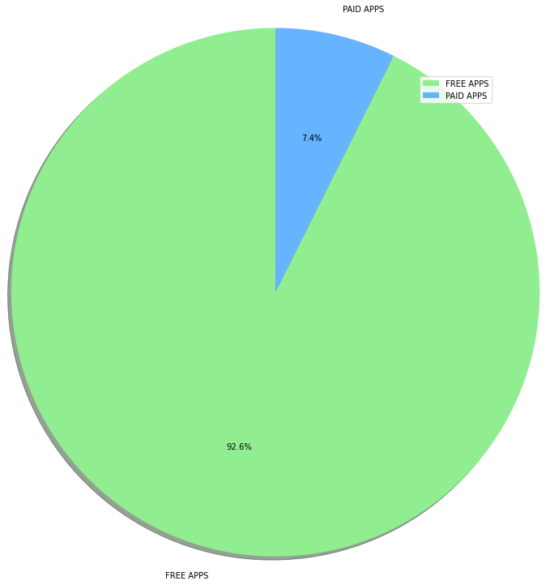

Percentage of Paid apps v/s Free apps
We Observed that 92.6% of Apps are free and only 7.4% of Apps are paid in Play store.

Slide 11
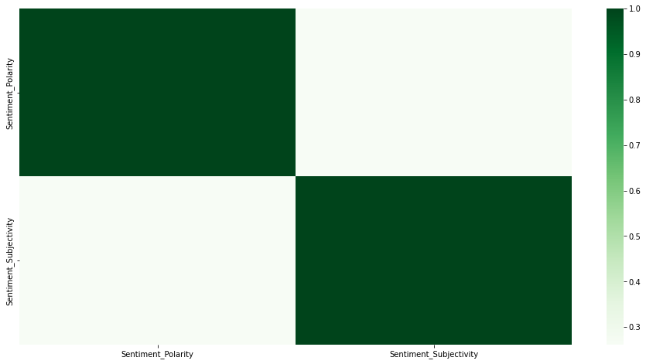
Correlation Heatmap
 | Sentiment Polarity | Sentiment Subjectivity
Sentiment Polarity | 1.000000 | 0.261587
Sentiment Subjectivity | 0.261587 | 1.000000
Note: After Analyzing Above Heatmaps, we can infer that we don't have any sort of good correlations between the different columns of both the data sets.

Slide 12
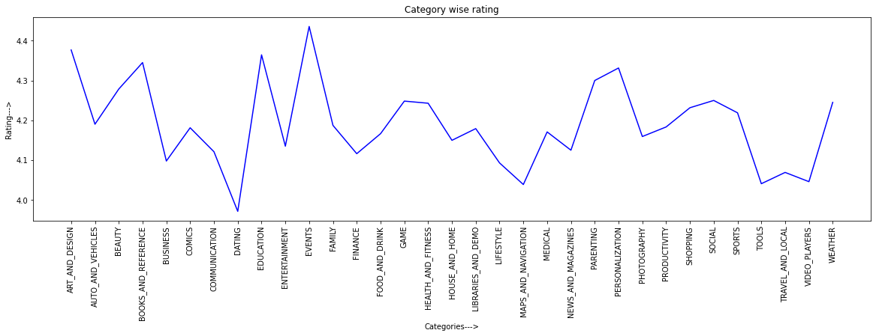
A Line Plot of Average Rating of Each Category of Apps

Slide 13
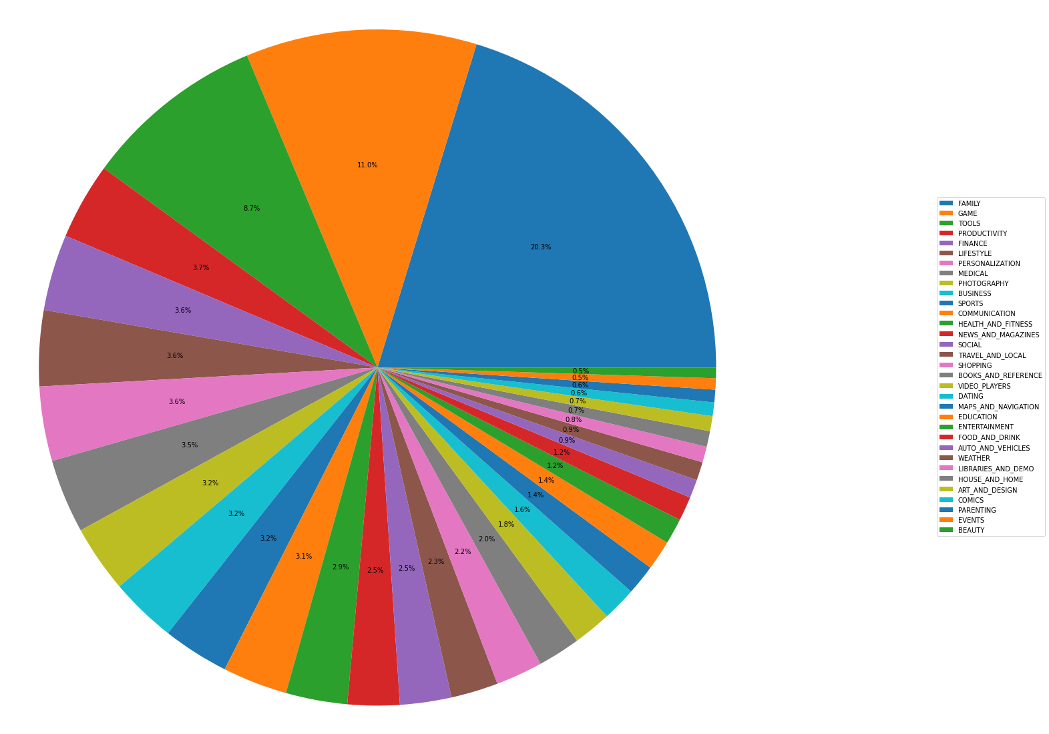
Basic Pie chart to View Distribution of Apps Across Various Categories
Findings
Rating is Highest for Family and Game category apps
Rating is low for Events and Beauty category apps

Slide 14
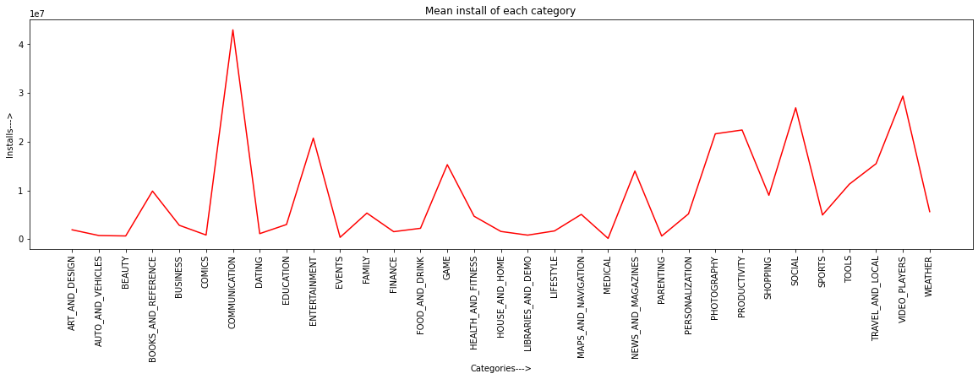
Mean Install of Each Category
Finding :
The Average installs is higher For communication category apps followed by social category apps4
The Average Installation is low for categories such as Beauty ,Comics ,dating, events, medical , and parenting.
Even though the Average rating is quite high for event category but the mean install is quite low

Slide 15
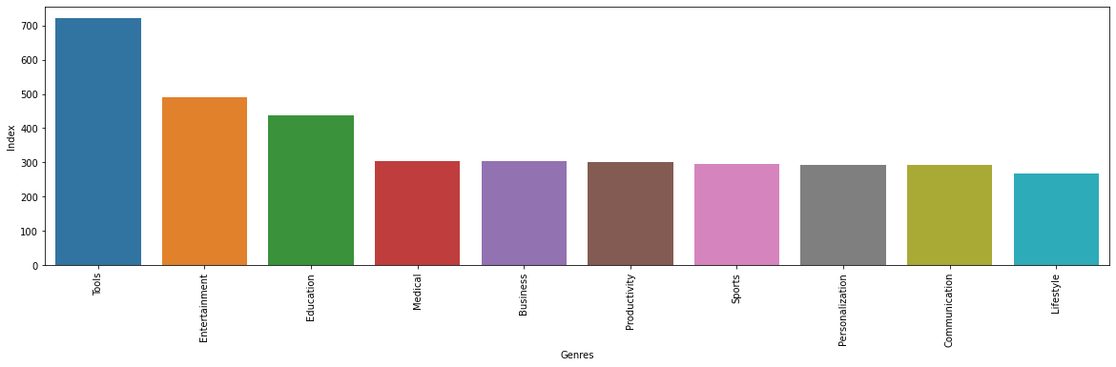
Top 10 Genres of Apps
Findings:-
Tools genre have the highest count followed by Entertainment.
Lifestyle genre have the lowest count followed by Communication.

Slide 16
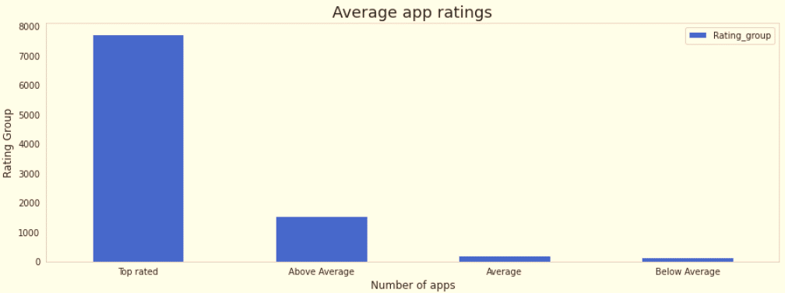
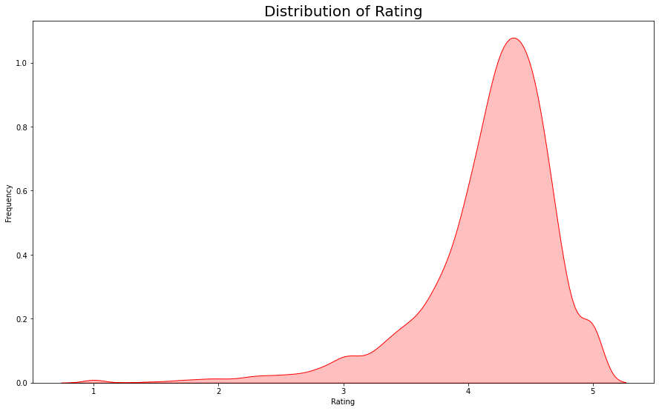
Distribution of Ratings of the apps
The average user rating is divided into 4 categories:
Rating: 4-5 ⇒ Top Rated
Rating: 3-4 ⇒ Above Average
Rating: 2-3 ⇒ Average
Rating: 1-2 ⇒ Below Average
The majority of the apps in the Play Store (~80%) are top rated.
This implies that the majority of the users are happy with the services received via the respective app
Findings:
From the above graph we can come to a conclusion that most of the apps in google playstore are rated in between 3.5 to 4.8

Slide 17
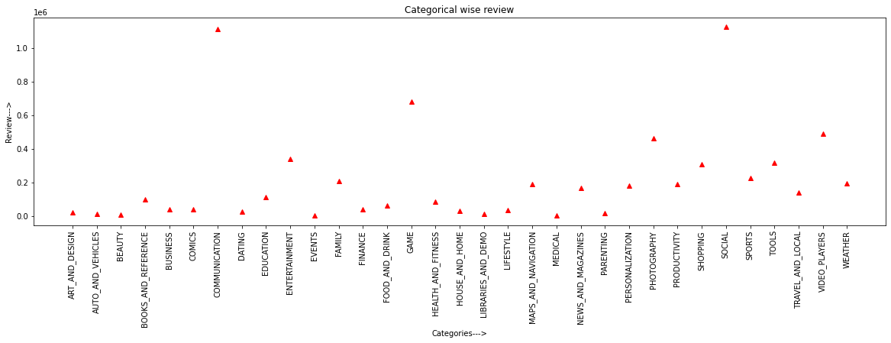
The average count of the number of reviews for each category of apps?
Findings
Most user- reviewed communication and social category apps.

Slide 18
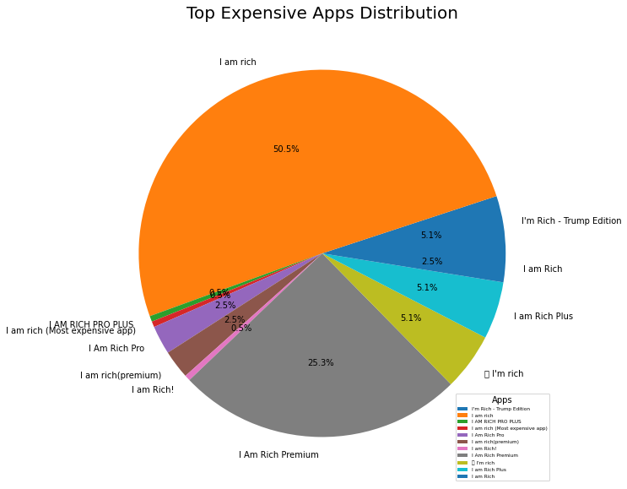
The top 10 expensive Apps in Playstore?
Findings:
From the above graph we can interpreted that the I am Rich app is the most expensive app in the play store. But this seems to be like a junk app. We need to further analyze if it is a junk app or not by deploying machine learning models in it.

Slide 19
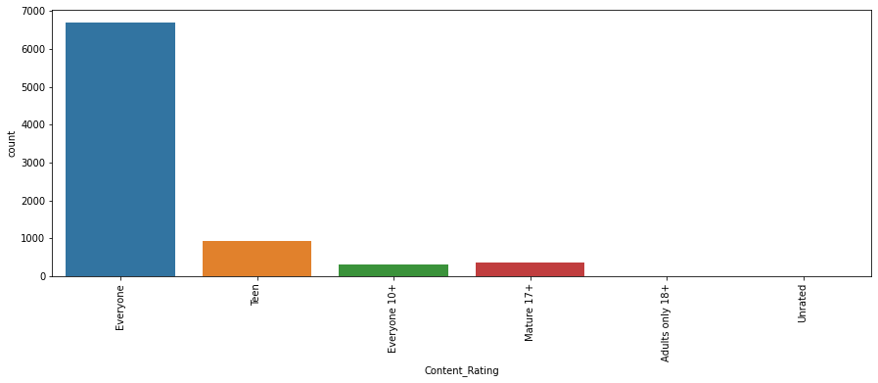
The Count Of Different Age Category Of Target Audience.
Findings
Everyone age group has highest the target audience.

Slide 20
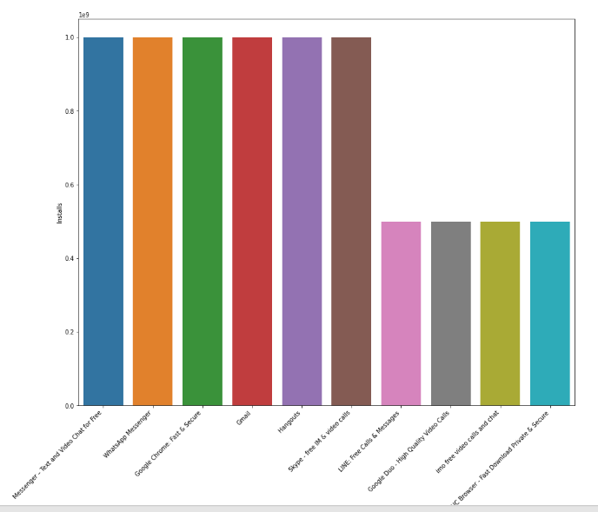
Top 10 Install Apps
Findings:
From the above graph we can see that in the Communication category Messenger- Text and Video Chat for Free, WhatsApp Messenger, Gmail has the highest installs. In the same way we by passing different category names to the function, we can get the top 10 installed apps.

Slide 21
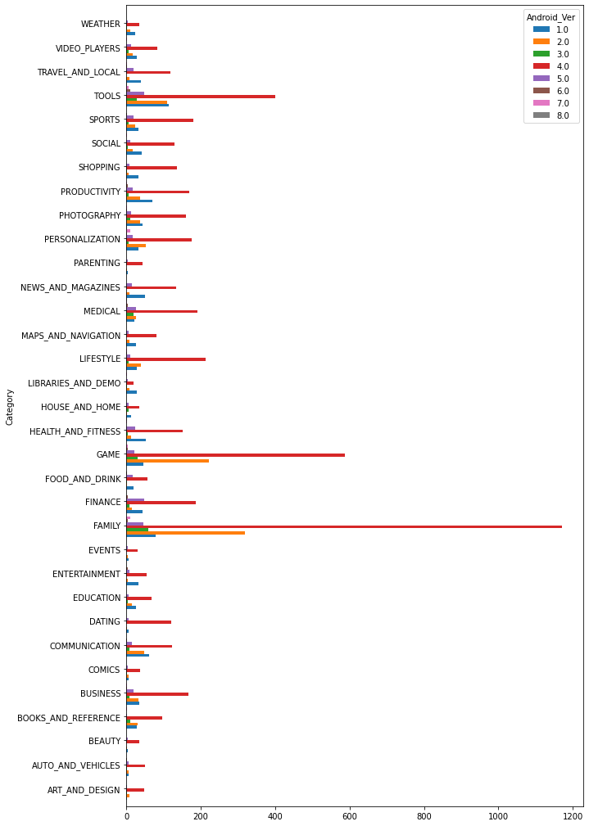
Android Version based on each Category
Findings:
It is clearly evident from the above plot that majority of the apps are working on Android_Ver 4.0 and up.

Slide 22
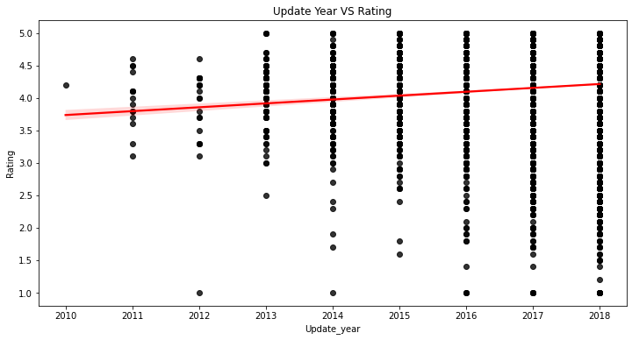
Does the last update date has an effect on rating?
Findings:
From above graph, we can conclude, the app gets more recent updates chances of getting a higher rating increases.

Slide 23
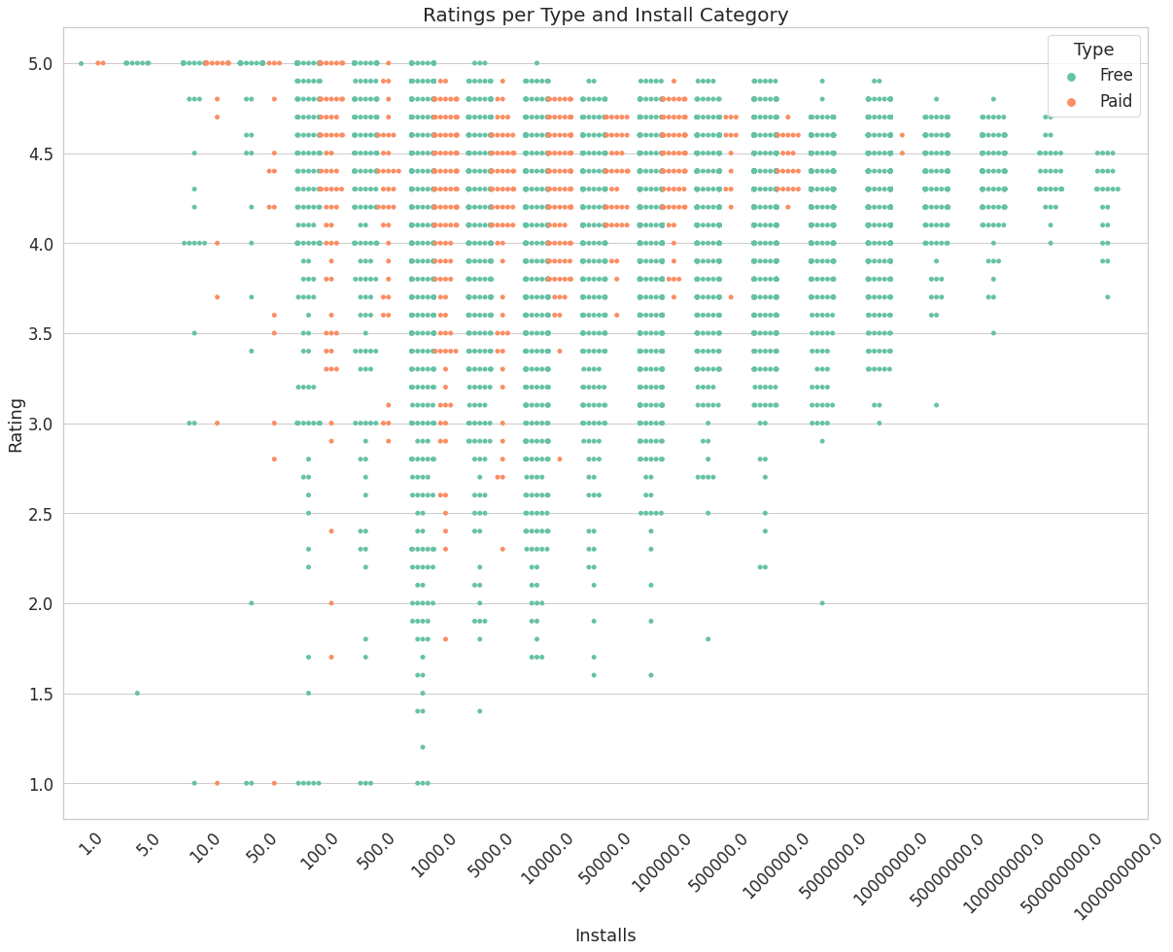
The distribution of rating per number of installs and type (paid or free)?
Findings
Rating per Install Category and Type
Looks like rating is distributed around 4.5 when its categorized per install category.
Google play store have very few paid apps.
CodeText

Slide 24
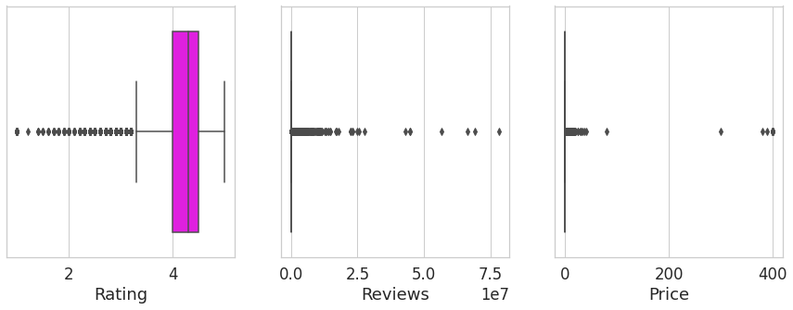
Is there any co-relation between rating, reviews and price columns together?.
Findings:
We can see that most of the Ratings are between 4 and around 4.5 and 5.
As far as Reviews are concerned, for most of the Apps Reviews are not given.
Also for Price, most of the Apps are Free.
CodeText

Slide 25
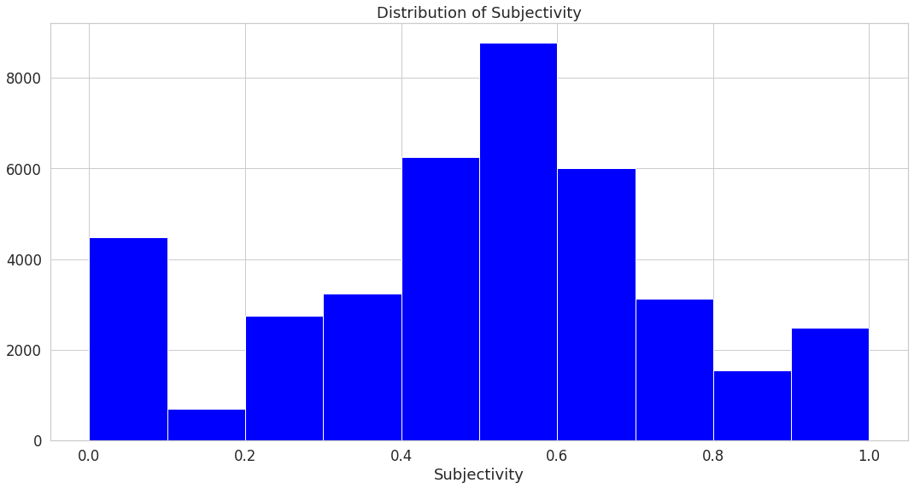
Histogram of Subjectivity
Findings:
0 - objective(fact)
1 - subjective(opinion)
It can be seen that maximum number of sentiment subjectivity lies between 0.4 to 0.7. From this we can conclude that maximum number of users give reviews to the applications, according to their experience.

Slide 26
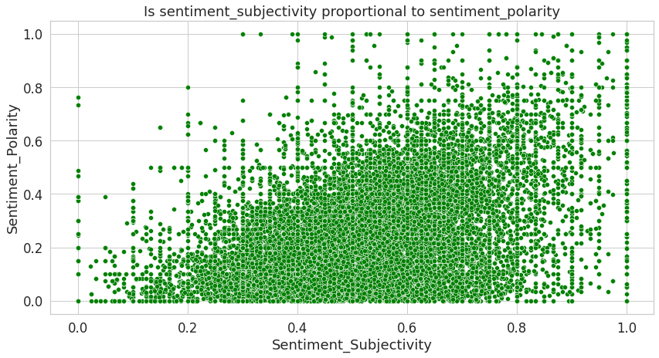
Is sentiment subjectivity proportional to sentiment polarity?
Findings:
From the above scatter plot it can be concluded that sentiment subjectivity is not always proportional to sentiment polarity but in maximum number of cases, it shows a proportional behavior, when variance is too high or low.

Slide 27
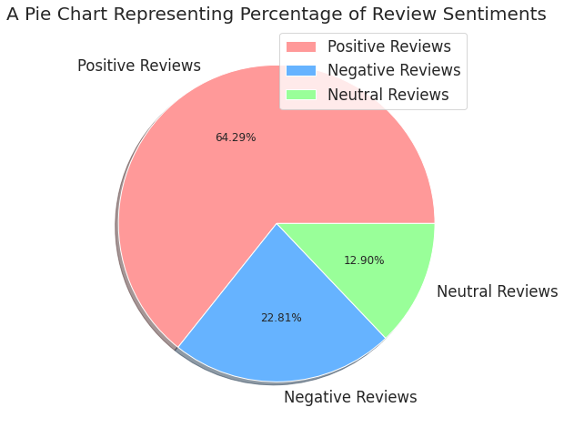
Percentage of Review Sentiments
Findings:
Positive reviews are 64.30%
Negative reviews are 22.80%
Neutral reviews are 12.90%

Slide 28
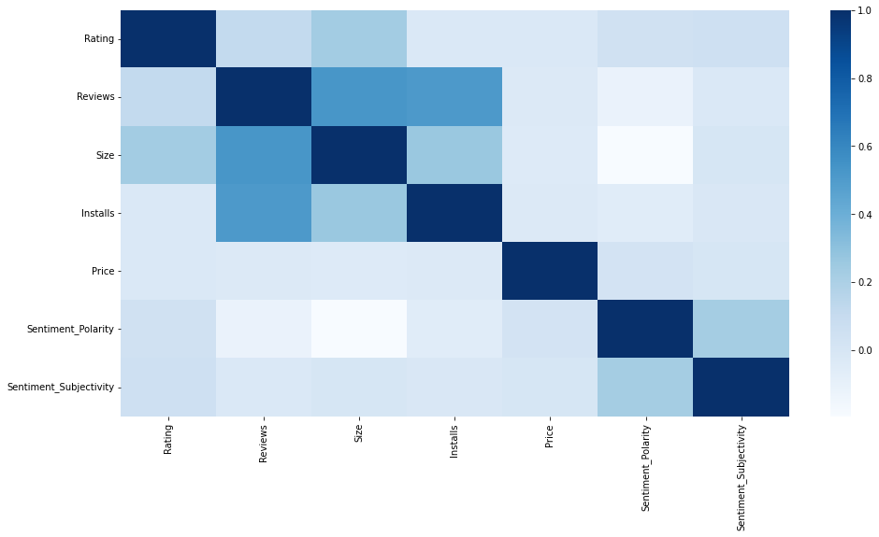
Co-Relation in merged data frame
In this correlation matrix, There is not a significant relationship between Rating, Reviews, Size and Installs with respect to the Sentiment polarity and Sentiment subjectivity.

Slide 29

Challenges Faced
Reading the dataset and comprehending the problem statement.
Examining the business KPIs for app development and devising a solution to the problem.
Handling the error, duplicate and NaN values in the dataset.
Designing multiple visualizations to summarize the information in the dataset and successfully communicate the results and trends to the reader.

Slide 30
Conclusion’s
Rating is very important factor for installation of apps as user mostly like to watch rating before using app. so developer should also work on updating their content as per the ratings.
From all above we analyze rating and installation are related, so owners should encourage to write review of their app.
Number of installation of free app is more compared to Paid app, so developer can also consider this point for high reach.
They need to focus on updating their apps regularly as it attract more people.
More installation of app in game app ,followed by communication ,productivity so if one can thinking to developer an app will go for these.
We can also see social media app is almost free, so keeping social media app free may be a great advantages over others.
App category like events and beauty have not much reach, so one can also keep this consideration.
Most of the apps are downloaded by teens, so users of other age category, must also be encouraged to install the apps.
From our above analysis we conclude that sentiments of the user keep varying, so owner need to keep updating their app regularly basis on user feedback.

Slide 31


